Slide 1

Building a Waste Classification Program
Capstone Passion Project
Alicia Bremer

Slide 2
Link:
http://35.233.236.48:8000/

Slide 3
Step 1: Brainstorming

Slide 4
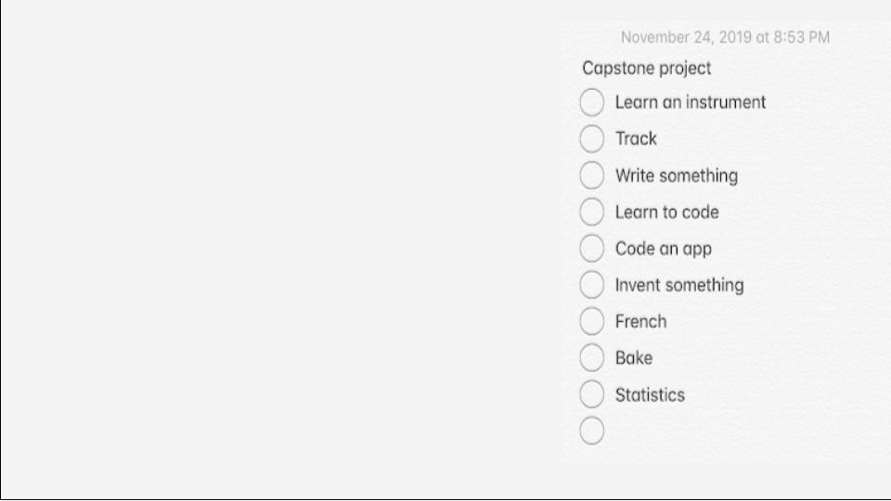
After brainstorming several ideas, I decided to research and learn about Artificial Intelligence and Machine Learning. Not only would I finally learn how to code, but computers and Artificial Intelligence are growing industries with many jobs that interest me.
BRAINSTORMING

Slide 5

The Essential Element
This product will address the Essential Element “to pursue excellence in all endeavours.” My program will help me develop my skills in coding, computers, research, and more. I will also be able to strive to improve my model and make it as accurate as possible.

Slide 6
Step 2:
Learning To Code

Slide 7
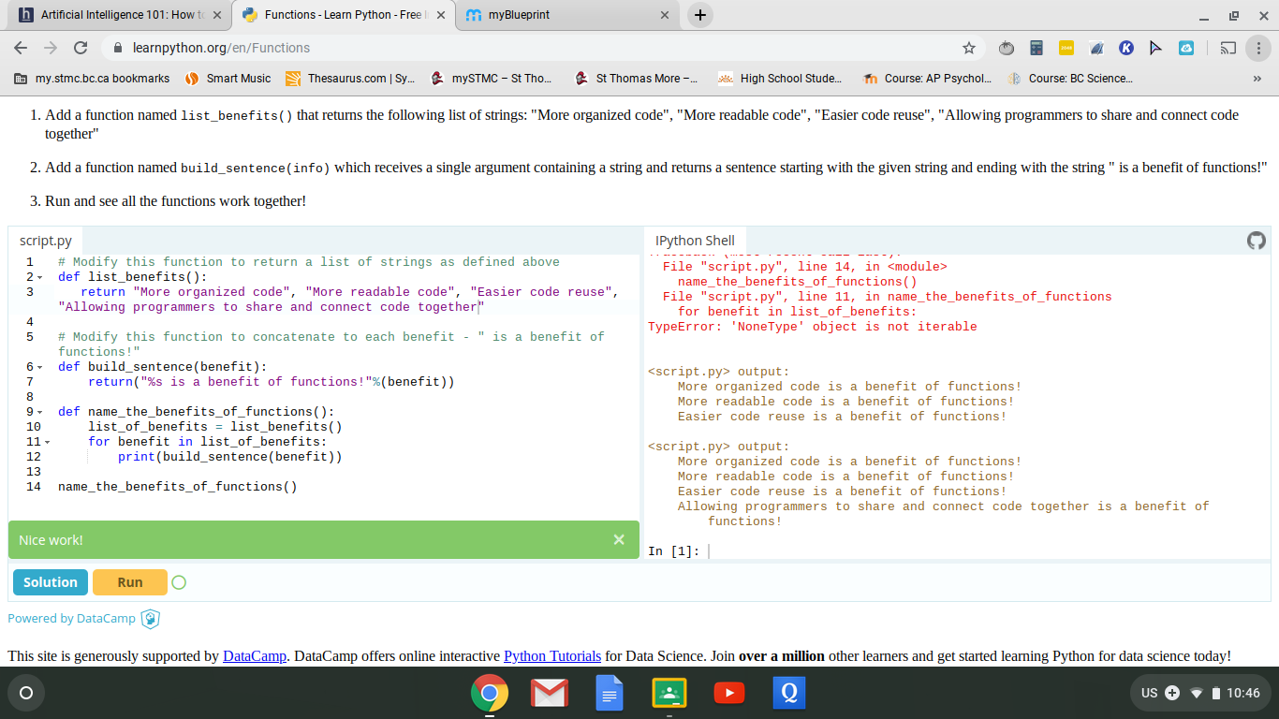
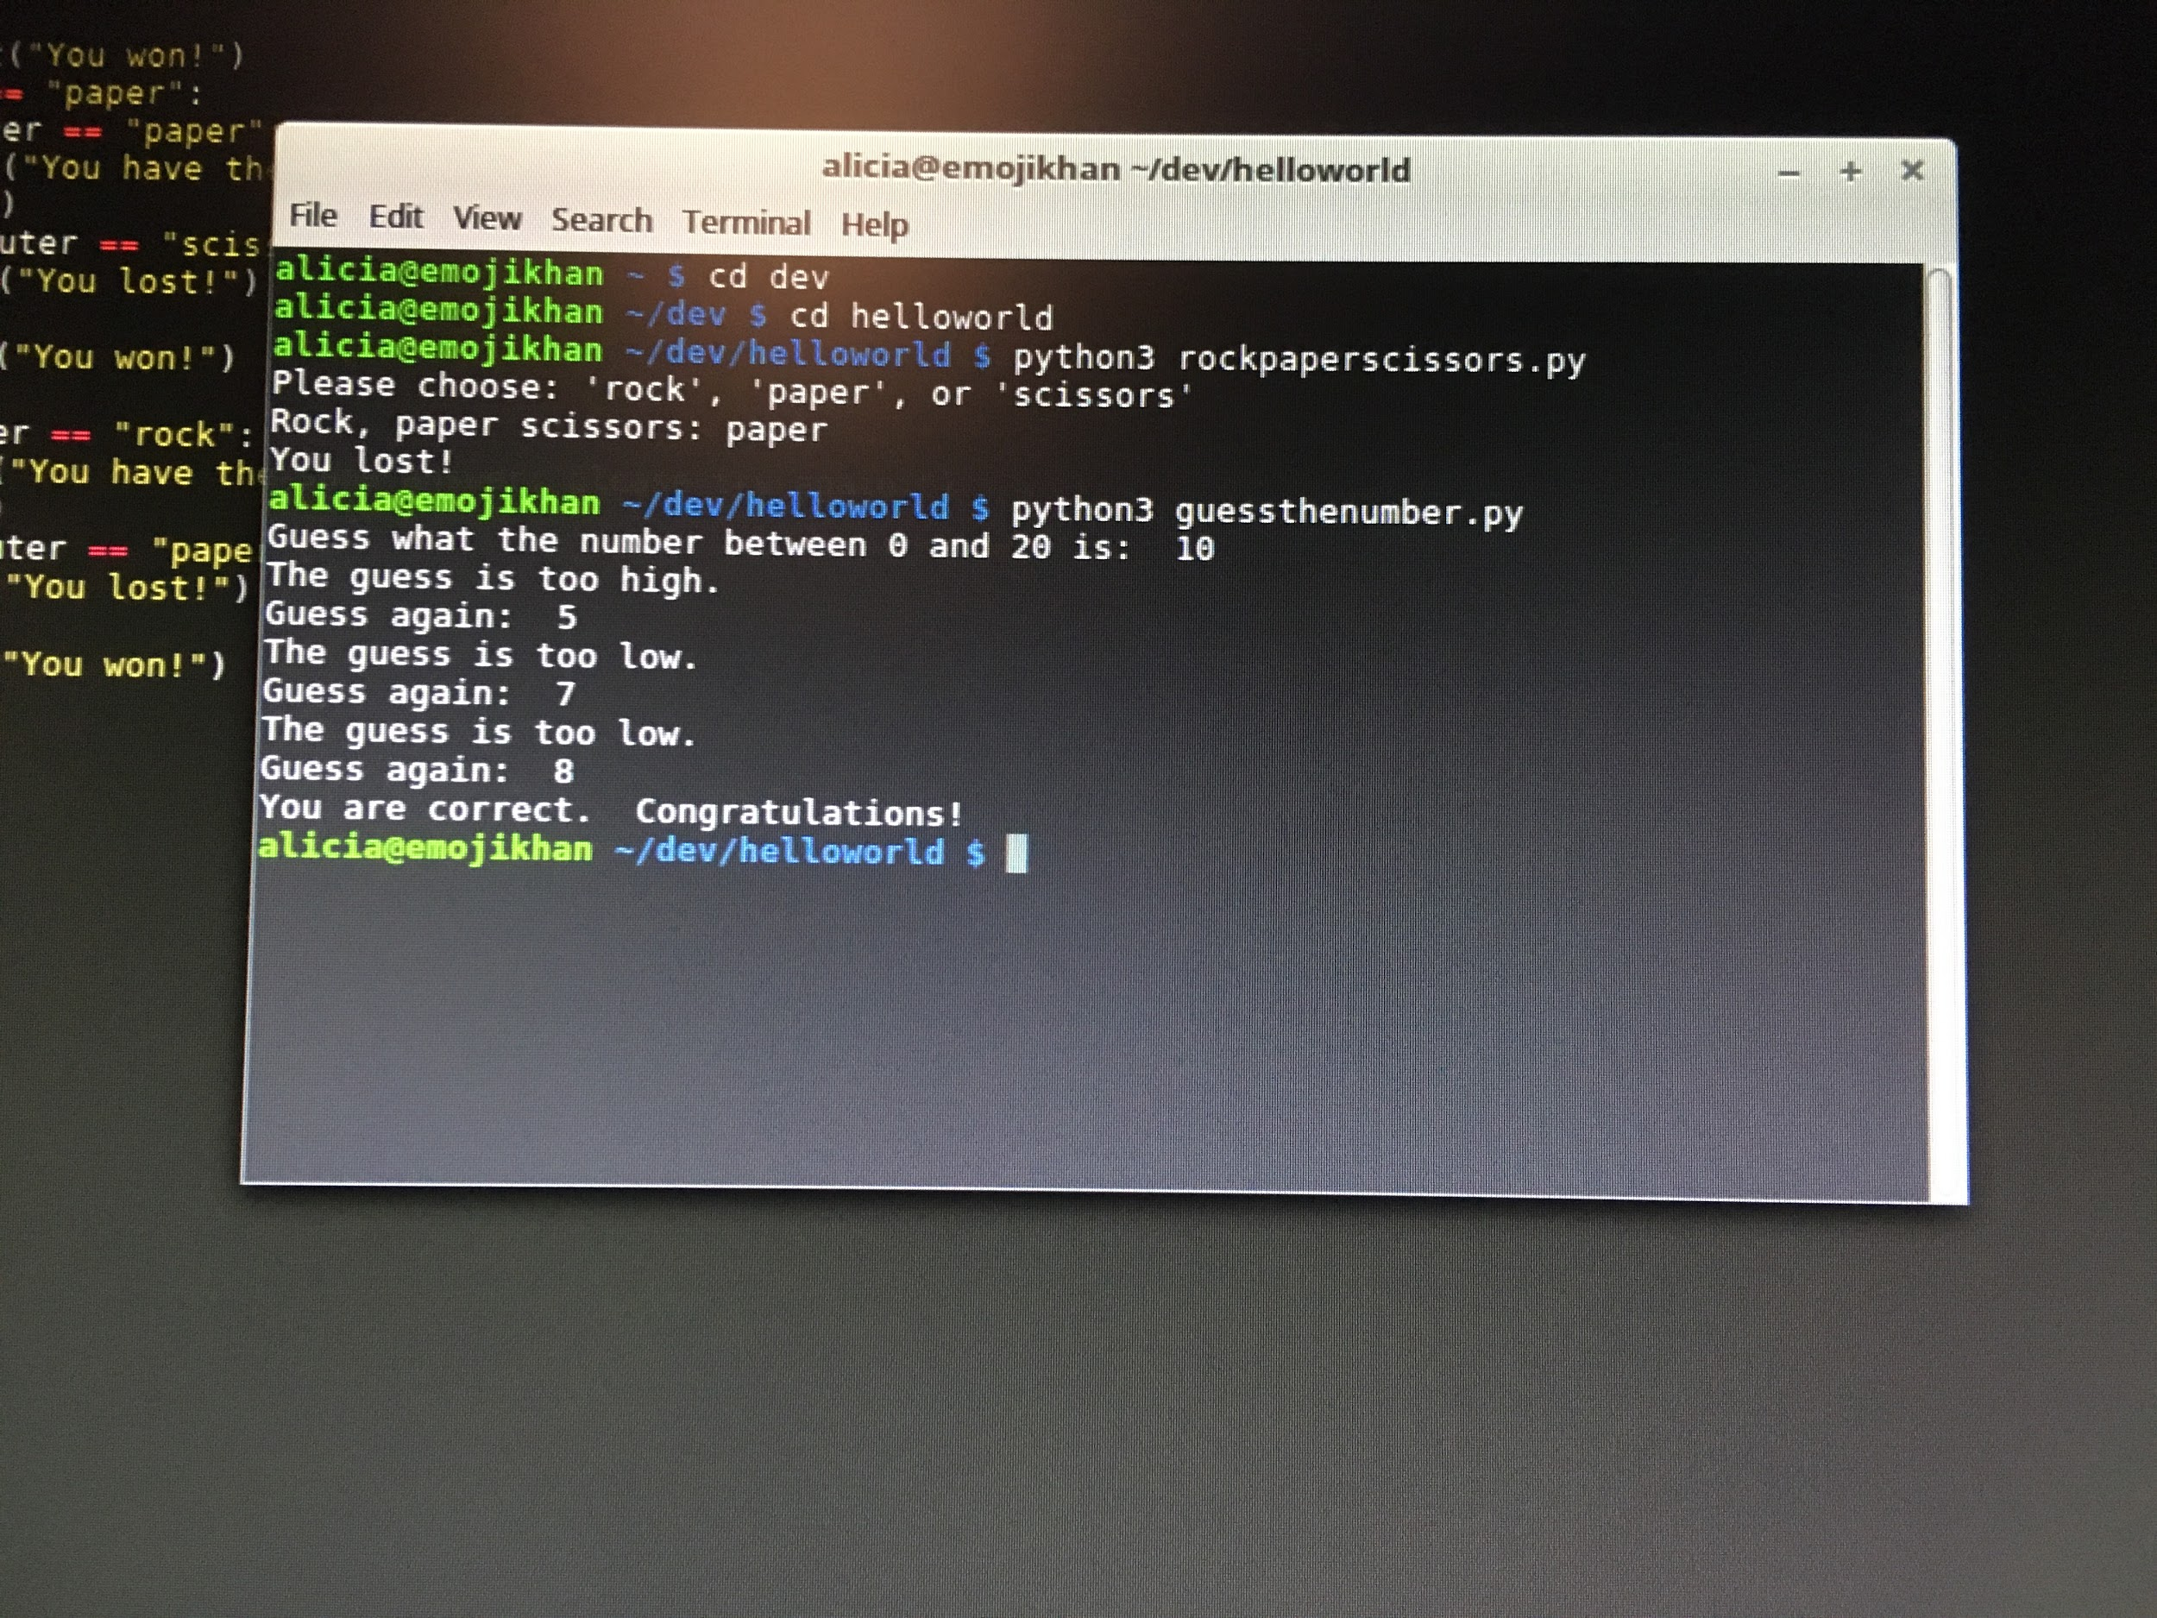
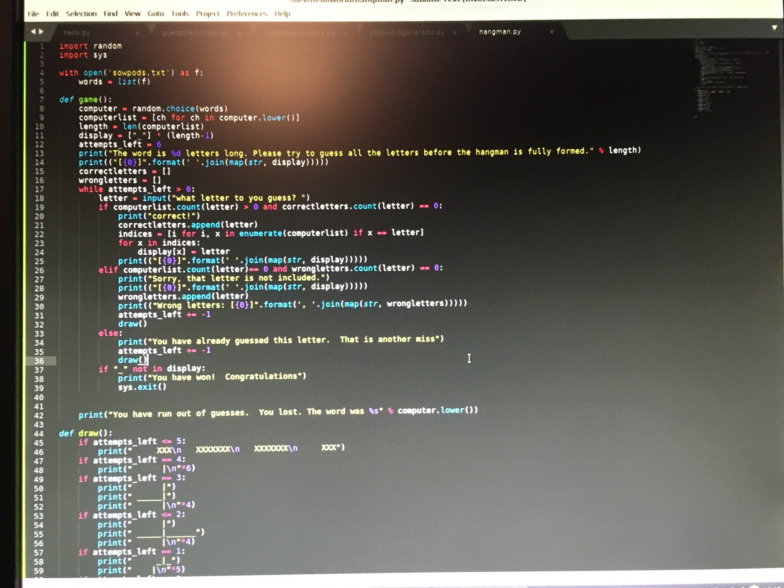
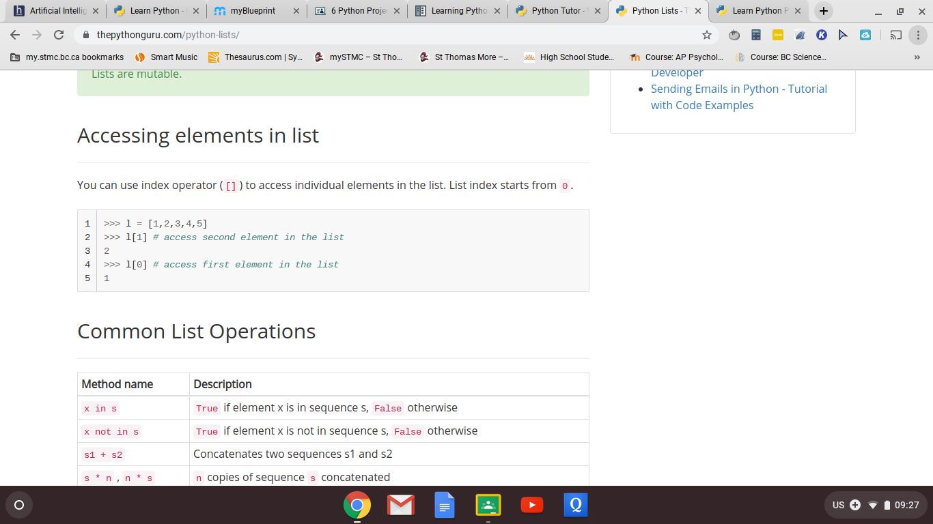
My first step was to learn to code Python, because this is the computer language used for most Machine Learning models. I have had very little exposure to coding, but there were lots of resources online.
Links of sites I used: https://thepythonguru.com/, https://www.learnpython.org%29/, https://www.codecademy.com/learn/learn-python-3

Slide 8
My mentor - my father - helped me troubleshoot and figure out how to get python running on the computer - and also pointed out that when he was learning to code, there was no Internet to help him in mere seconds. My dad is a software engineer and has a wide background in coding and computers.

Slide 9

Core Skill: Personal and Cultural Identity
My Capstone has led me to fully embrace my nerdiness as part of my identity! I also realize that I have access to way more information and technology due to living in the 21st century - and even compared to just a few years ago.

Slide 10
Step 3:
Discovering Machine Learning

Slide 11
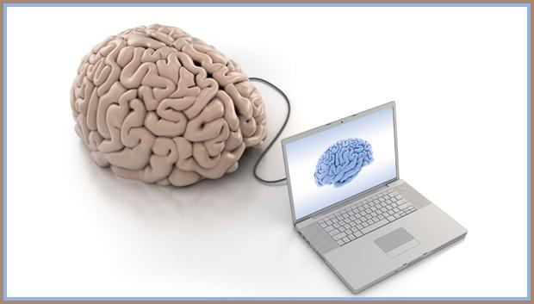
Through a site called Kaggle, I was able to do several free Machine Learning courses, which helped me understand what Machine Learning was and how it worked.
This site also allowed me to participate in several basic contests to help me practice my newly learned skills. Throughout my Capstone (and beyond), Kaggle has been invaluable in helping me discover the Machine Learning world.

Slide 12
So what is Machine Learning, anyways?
Machine Learning
is an application of Artificial Intelligence that provides systems with the ability to learn and improve from experience.
Artificial Intelligence
Is ​a branch of computer science dealing with the simulation of intelligent behavior in computers.

Slide 13
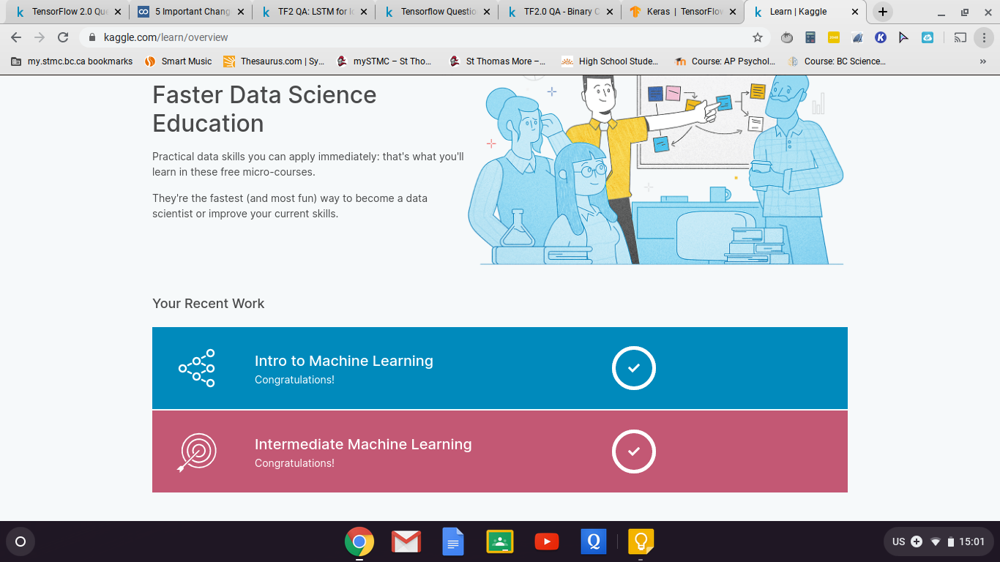
TWO OF THE COURSES I COMPLETED

Slide 14
Core Skill: Personal Awareness
I became more aware of my interests in coding and computers, especially Machine Learning, while doing these courses on Kaggle. I realized that this is something I would want to pursue in the future, and have now been doing even more courses and competitions on Kaggle.

Slide 15
Step 4:
Determining My Final Product

Slide 16
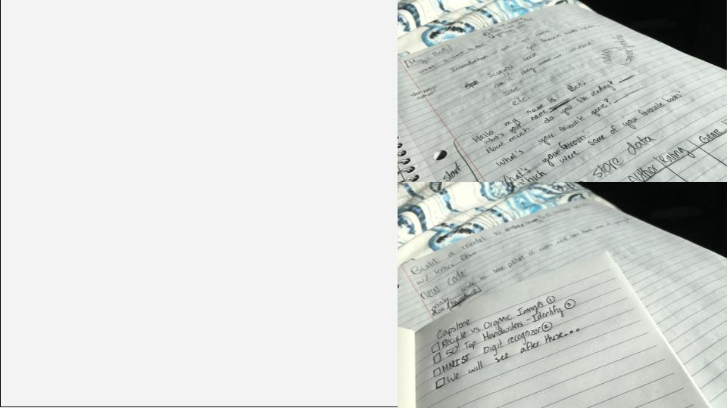
Initially, I planned on making a bot to recommend recipes/books to a user. However, I wanted to change my project to be feasible with datasets on Kaggle. I considered making a program to take an image of notes and make it into text, before settling on building a Waste Classification model to sort waste. This idea was both realistic, challenging and achievable, especially because there were already datasets on Kaggle.

Slide 17
Core Skill: Building Community
Core Skill: Thinking Creatively
My Capstone project helps build community by promoting sustainability - some members of STMC Green Team even helped me with some pictures I needed for my model!
Deciding on a final project idea also required thinking creatively, as I had to revise initial ideas to make them more realistic and just as innovative.

Slide 18
Core Skill: Critical Thinking
Core Skill: Social Responsibility
I used critical thinking to evaluate my ideas to figure out which ones would work and which ones would not. I also had to evaluate different datasets on Kaggle to find the best ones.
One social responsibility everyone has is to the environment, and this Capstone project is a way for me to help myself - and others - be more aware and active in this responsibility.

Slide 19
Step 5:
Building the Model

Slide 20
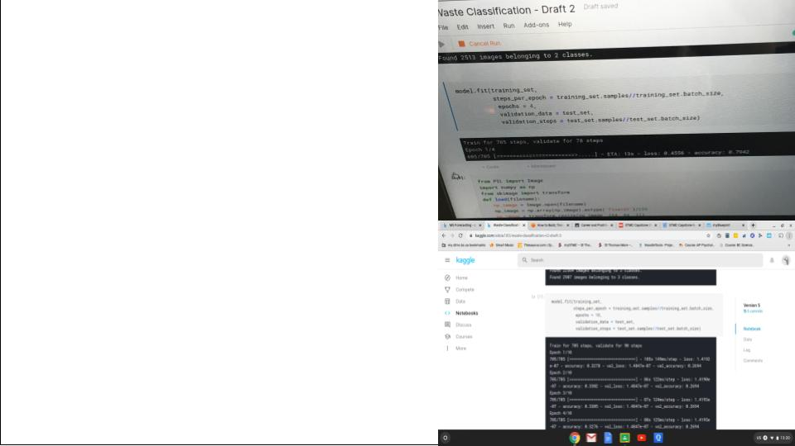
Using a dataset on Kaggle, I was able to build and train a model to classify waste. Initially, my model only classified images as organic or recyclable. I expanded the model to classify images as organic, recyclable or non recyclable.

Slide 21

A video of my model classifying 3 images

Slide 22
Step 6:
Assembly

Slide 23
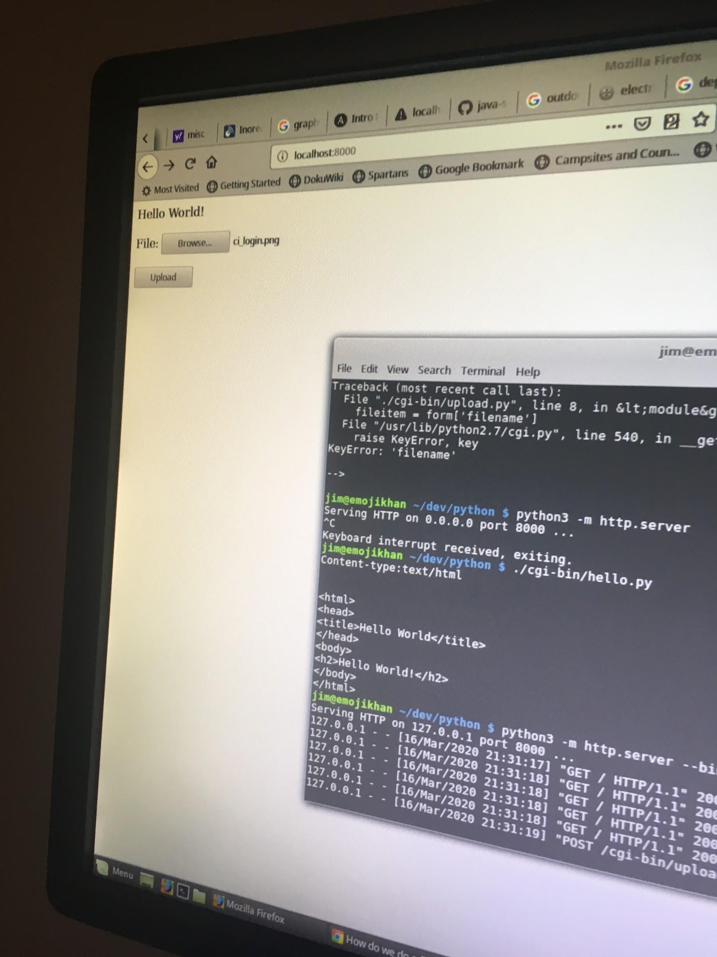
Next, I wanted a platform to run my model. Using Google Cloud, I was able to make a python site that could run on whatever device I wanted. I learned a lot, especially about using Google Cloud, vi and how computers work. However, once I got my site running, I realized that I had to troubleshoot my model a bit more.

Slide 24
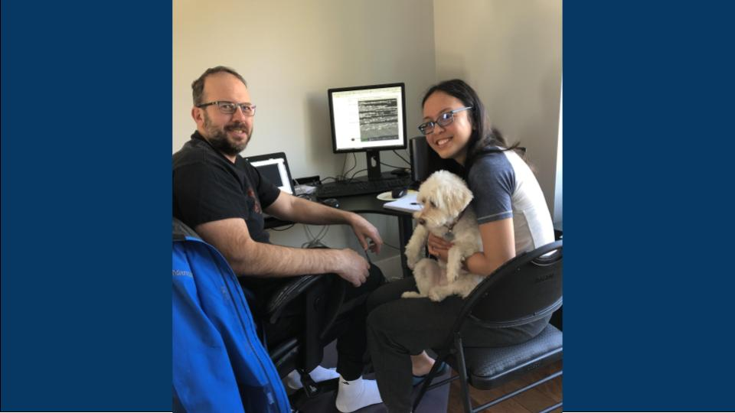
Here is an image of my mentor and I working on putting my model onto a Google Cloud website.

Slide 25
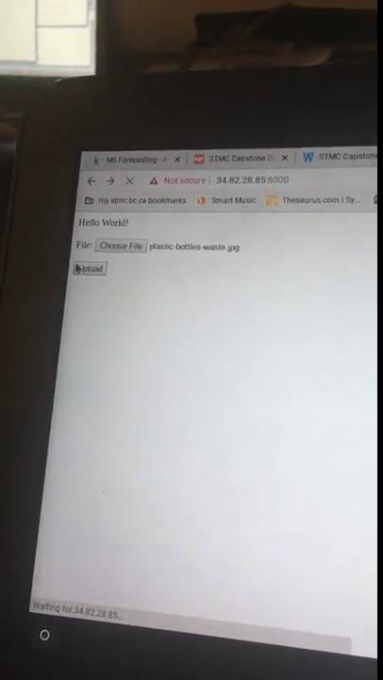
Although my website worked, I quickly realized that my modeled classified EVERYTHING as organic...

Slide 26
Step 7:
Troubleshooting

Slide 27
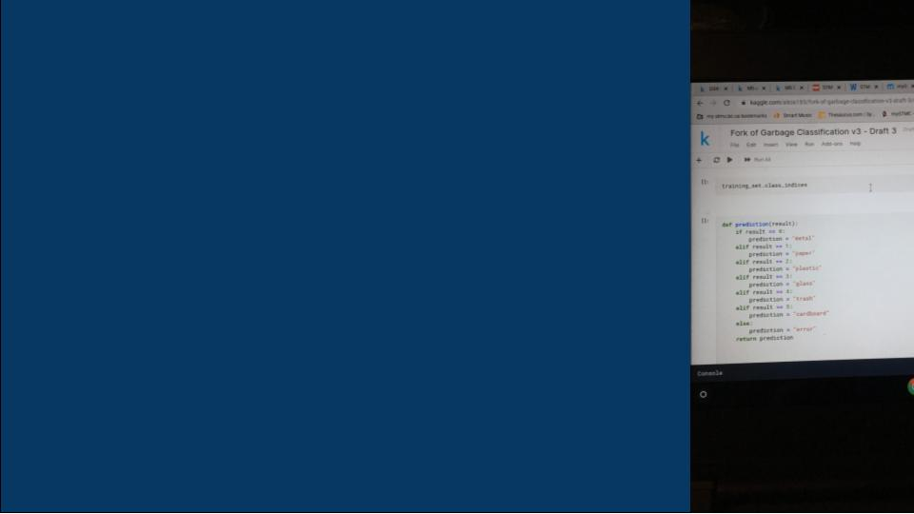
There were several problems I had to fix in my model. First was that it did not classify images into the proper classes. During this stage I also switched the dataset the model was trained on so that it classified images into 6 categories of waste - Trash, Cardboard, Metal, Plastic, Glass and Paper - as I did not like the organization of the previous dataset.

Slide 28
I increased the training to 1000 iterations and saved the most accurate model - it took 8 hours to train!

Slide 29
The Final Product

Slide 30
The link is:
http://35.233.236.48:8000/

Slide 31
Thanks for watching!

Slide 32
Credits
Special thanks to all the people who made and released these awesome resources for free:
Presentation template by SlidesCarnival
Photographs by Unsplash

